Slide 1

Information Systems
Transforming Data into Action
Nagy Corp
PRESENTED TO
PRESENTED BY
the Doctor
Nagy Mohamad

Slide 2

Information Systems Strategy: Theoretical Foundations and the Reality of System Failure .
TRANSFORMING DATA FOR EFFECTIVE USE
Information systems move to human-centred approach

Slide 3

The Need for Theoretical Foundations
Key Idea: Historically, Information Systems Strategy (ISS) was viewed objectively as something to be 'planned' or 'designed towards'.
The text argues for a reassessment of ISS based on corporate strategy and information systems, promoting a more human-centred, participative approach
This approach is critical because strategic problems are often less amenable to simple, fixed-plan solutions, especially with rapid technological change

Slide 4


Social Theory and the Paradigm Problem
The main consideration is the debate around managing IS as a mixture of technical and social issues within a broader organizational context.
KEY APPROACHES
Key Approaches:
Social Systems Theory: Explores information systems and strategy.
Critical Social Theory and Critical Systems Thinking: Provides a framework that goes beyond purely technical or objective approaches.
CORE TOPIC:
Understanding the theoretical underpinnings of ISS begins with social theory.

Slide 5

The Critical Systems Perspective
Concept: Critical Systems Thinking is a framework that can synthesize the objective ('hard') and subjective ('soft' or human-centred) aspects of IS.
It acknowledges that IS must be studied within the context of both technical systems and human activity systems
This perspective is crucial for developing a robust strategic framework for information systems.

Slide 6

The Reality of System Failure
Startling Statistic: Studies have concluded that up to 90% of Information Technology (IT) investments do not meet their set performance goals.
Primary Causes: The technology-led nature of the development process and a lack of attention to human and organizational factors.

Slide 7

Classification of Information Systems Failure
Correspondence failure: The completed system does not match the specification determined in advance.
Process failure: Failure in the development process, such as a cost overrun or inability to complete development.
Interaction failure: Users fail to use the 'system' sufficiently, effectively rendering it a failure.
Expectation failure: The completed 'system' fails to meet the expectations of its participants.

Slide 8

The Key to Success: User Involvement
Solution: A key factor in Information Systems (IS) success is user involvement.
The human-centred approach recognizes that understanding human activity is at least as important as understanding organizational or technological issues
Action Research : is a technique that involves users in both the strategic and operational process to enhance system success.

Slide 9
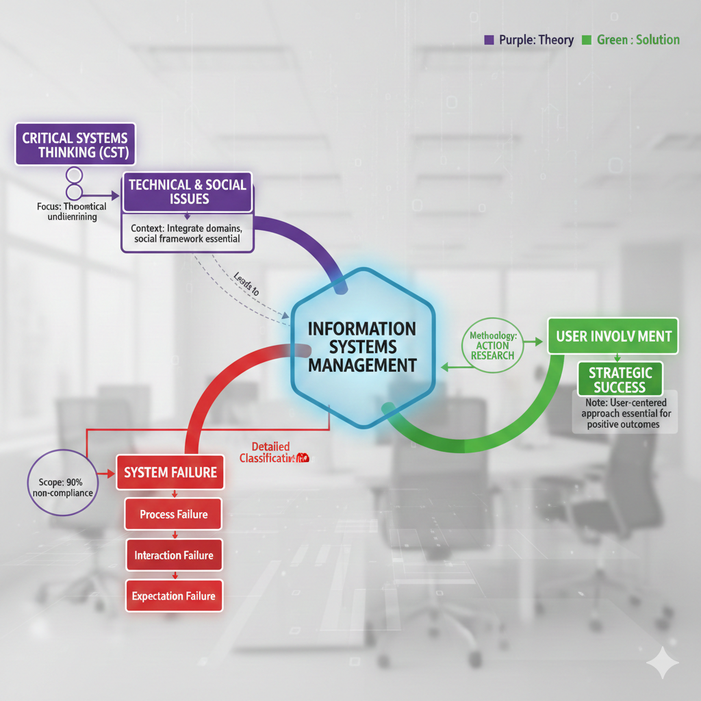
Mind Map
Link 1 (Theory): Critical Systems Thinking → Technical & Social Issues
Link 2 (Problem): System Failure (90% non-compliance) → Classification (Correspondence, Process, Interaction, Expectation Failure)
Link 3 (Solution): User Involvement → Action Research → Strategic Success

Slide 10

Practical Side
Application Focus: Using Action Research to bridge the gap between technical and social problems, as discussed in Chapter 4
Practical Example (IS Failure): The London Ambulance Service. The system was undertaken as a predominantly technical solution to a problem in a highly socio-cultural environment. The failure was partly attributed to a lack of participant involvement from care staff, who found the developers' terminology impenetrable
Practical Recommendation (IS Success): Implement Action Research. This involves having those involved in and affected by the system actively participate in defining the problem and the solution. This is a practical way to manage the 'patterns of activity' (emergent strategy) and address human-centric complexity

Slide 11
